Slide 1
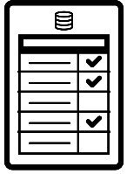



MAG Metrics Reporting
A Case Study
1) The Task
Analyse the data contained in their
platform supplied logfile reports.
Cross-reference against the data in theIPregistry.org .
Report back to identify the organisations that desired access to content but were turned away.
3) The Results
625,000 IP addresses matched.
12,500 unique organisations identified.
Analysis of organisation category (70% Academic, 16% Corporate, 14% Government).
40 different organisation types identified.
Geographic breakdown identified 158 different countries.
2) Data provided
IP address of attempted access.
Time/Date stamp.
Series title, series code
and DOI.
This information allows MAG to identify organisations that desired access to content but were turned away either because they have no active subscription or because they do not have the correct access. This allows MAG to target new customers in the knowledge that the content is truly needed and with the ability to demonstrate this. They can also upsell to existing customers.
Why did they need to work with PSI? MAG cannot interpret this information themselves, neither can other metrics providers or platform providers, as they do not have access to the full range of data available in theIPregistry.org . They only have access to data for their existing customers.

Slide 2
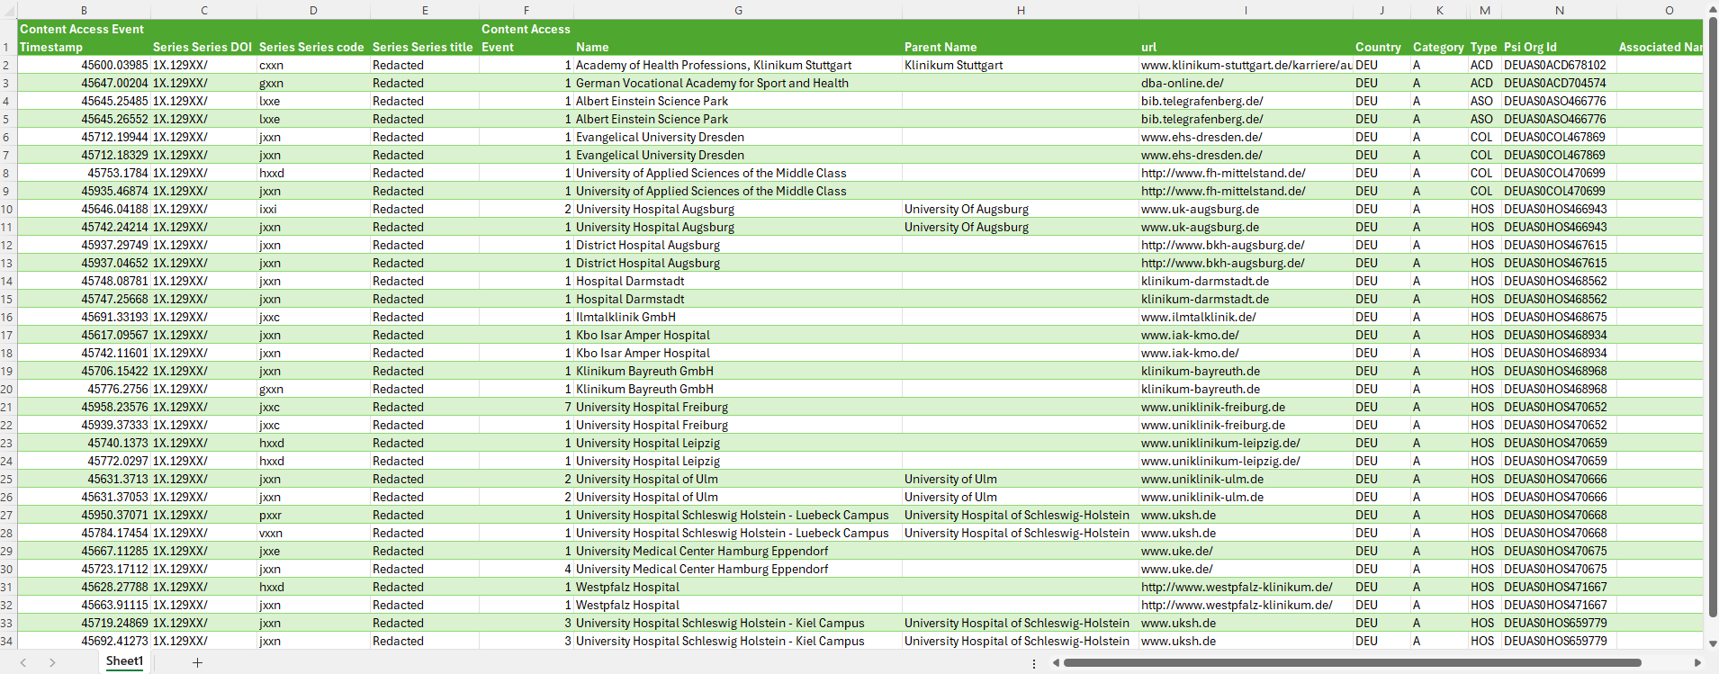
Results provided in simple spreadsheet format

Slide 3
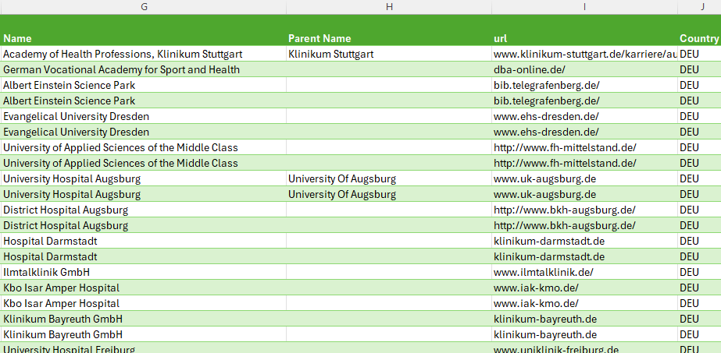

Data can be spliced and diced to reveal detailed information
Results indicate organisation category (Academic/Corporate/Government) as well as type of organisation and full PSI OrgID
Details of organisational hierarchies are provided
Country and urls are provided for additional disambiguation
Organisations are clearly identified using clear, standardised naming protocols

