Slide 1
The Due Diligence Bureau
Demonstrate compliance
- with PSI’s DDB service

Slide 2
Why do we need DDB?
In 2011 Macmillan Publishers were fined in excess of £11 million
In 2012 OUP were fined £1.9 million
Both companies were excluded from competing for World Bank contracts for 3-6 years
In both cases it was found that corrupt behaviour was confined to a small part of the organisation
However, it was decided the companies hadn’t done enough to prevent corrupt behaviour

Slide 3
What can we do?
The Due Diligence Bureau:
helps publishers to educate all intermediaries of the appropriate levels of conduct
Provides assurances from intermediaries that the law will be adhered to
Allows publishers to demonstrate the measures they’ve taken to prevent unlawful behaviour

Slide 4
Helping our customers to demonstrate compliance
For the last 9 years the DDB service has given our customers insurance against risk, helping them to demonstrate compliance and avoid hefty fines of the likes imposed on both Macmillan Publishers and Oxford University Press.

Slide 5
How does it work?
1)
2)
Publisher provides list of intermediaries / agents
Publisher list is matched against DDB database
3)
Compliance questionnaire sent to intermediaries / agents
4)
References are requested and details are stored in the database.

Slide 6
4)
Intermediaries confirm they have watched the training video.

Slide 7
6)
Up to 5 follow-ups and chasers if required
7)
When replies are received intermediaries are checked using LexisNexis and Internet searching
8)
Result uploaded to database (with company data, reports and evidence)
Checking for evidence of either legitimate business or instances of “negative news”

Slide 8
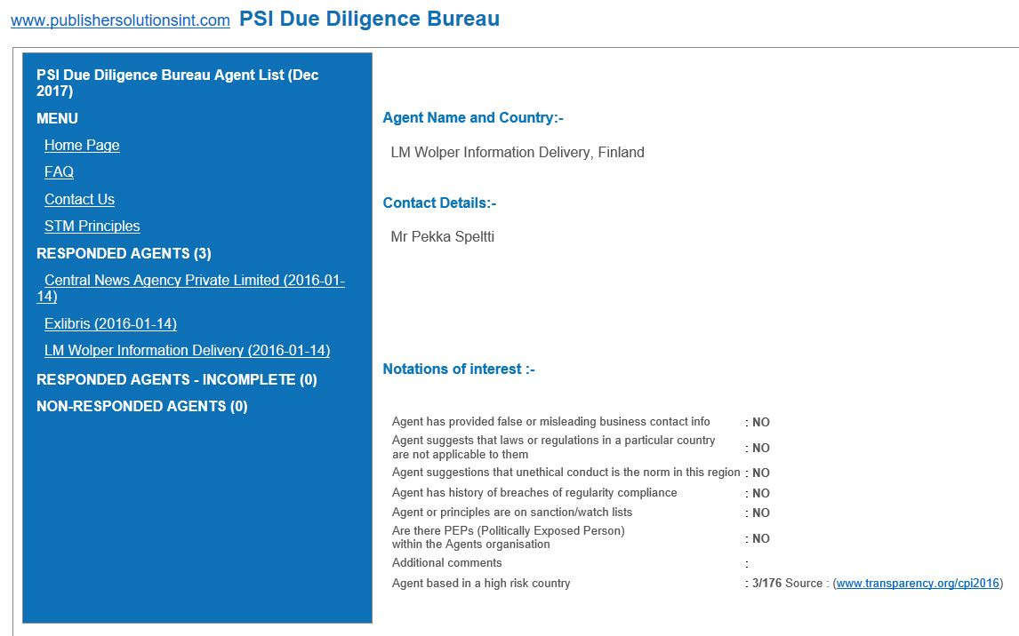
Results
Provided in regular reports
And available via DDB interface
XX Xxxxxxx xxxxxxxxxxx xxxxxxxx, xxxxxxx
XX Xxxxx Xx xxxx
Xx xxxx Xxx xx Xxxxxxx Xxxx x xxxxxxx,
Xxxxxxx
Xx xxxx Xx x xx Xxxxxx Xxxx x x

Slide 9
Benefits
Decisions can be made based on the information provided
Company passes compliance tests

Slide 10
For further information please contact:
info@PSIregistry.org
Other PSI products available include:
PSI Metrics – OA analytics and denials reporting
PSI IP Registry – the IP management tool
PSI Gap Analysis Tool – access a databank of customers subscribing to the content of over 150 STM publishers
PSI IP-Intrusion – join the publisher community driven fight against cybercrime
Photo by Crew on Unsplash

