Slide 1

The Due Diligence Bureau
Demonstrate compliance with sanctions and observation of human rights
Prevent unlawful behaviour (corruption, bribery, fraud and money laundering)
- with PSI’s publishing specific DDB service

Slide 2


Why is Due Diligence Important?
Due Diligence on intermediaries helps prevent legal and reputational risks.
Global laws like the FCPA, the OECD anti-bribery convention and the UK Bribery Act impose strict anti-corruption requirements on companies, holding them responsible for misconduct by their intermediaries worldwide.
Publishers face significant bribery risks due to reliance on third-party intermediaries for key services.
Due Diligence is a strategic necessity that prevents losses and protects reputation beyond mere compliance.
Legal Overview​
The FCPA prohibits bribery of foreign officials and requires strong internal controls and risk-based due diligence.​
The UK Bribery Act enforces strict liability for bribery by associated persons unless adequate procedures exist.​

Slide 3
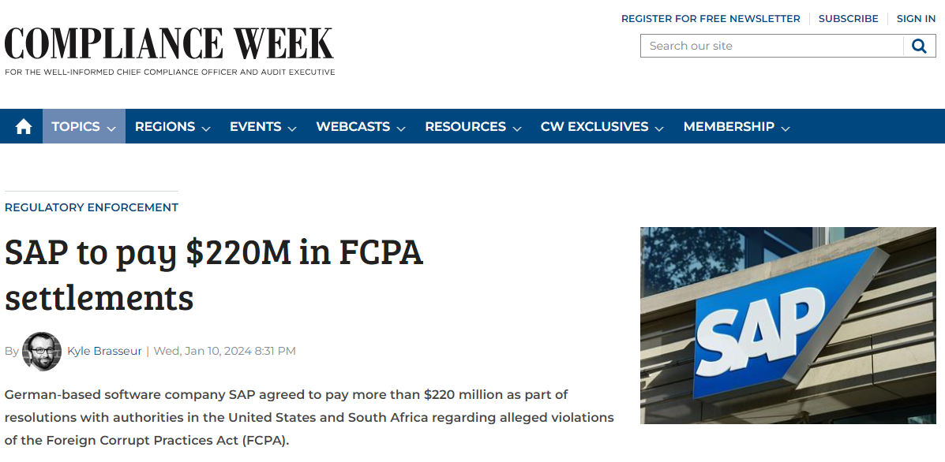
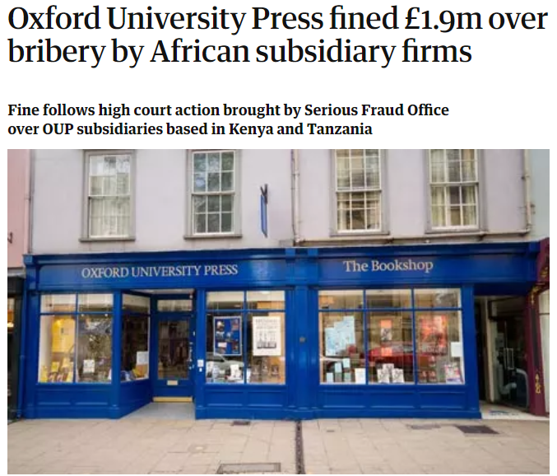
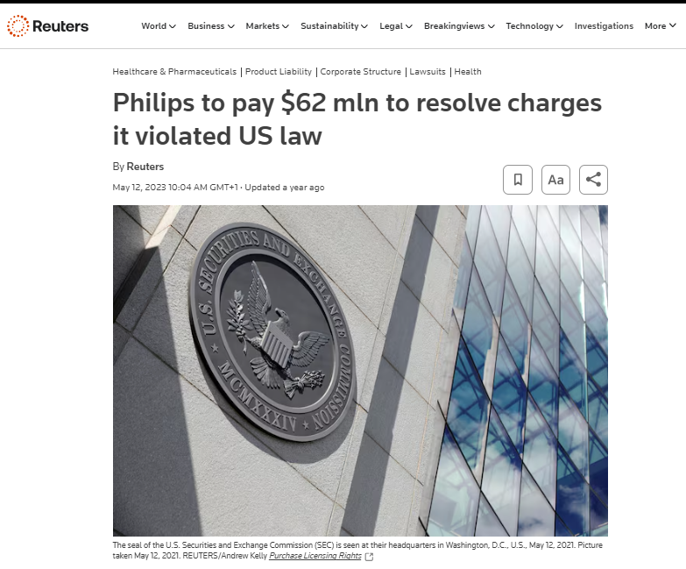

Helping our customers to demonstrate compliance
PSI’s DDB service gives our customers insurance against risk, helping them to demonstrate compliance and avoid hefty fines of the likes imposed on both Macmillan Publishers and Oxford University Press. And more recently on companies like Philips and SAP.
SAP agreed a settlement for violating the anti-bribery provisions of the FCPA. SAP, through its wholly-owned subsidiaries, employed third-party intermediaries and consultants in various schemes to pay bribes to government officials in order to obtain business in South Africa, Malawi, Kenya, Tanzania, Ghana, Indonesia, and Azerbaijan. (1/10/24)
No publisher using our DDB service has ever been fined, and all those audited have passed with flying colours.
Philips agreed to pay $62 million in connection with its operations in China where employees at Philips’ Chinese subsidiaries, distributors or sub-dealers sought to improperly influence government hospital officials to increase the likelihood that Philips’ products would be selected in public tenders. (05/11/23)

Slide 4
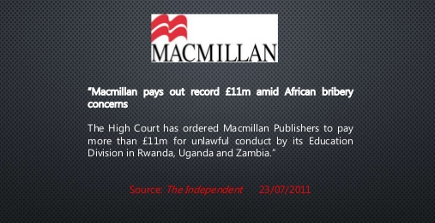
Why do we need DDB?
Non-compliance may lead to multi-million fines and significant reputational damage for companies.
In 2011 Macmillan Publishers were fined in excess of £11 million.
In 2012 OUP were fined £1.9 million.
Both companies were excluded from competing for World Bank contracts for 3-6 years.
In both cases it was found that corrupt behaviour was confined to a small part of the organisation. However, it was decided the companies hadn’t done enough to prevent corrupt behaviour.
In recent years prosecutions have continued at pace and many organisations, such as Koninklijke Philips N.V. and SAP have fallen foul of the rules, often with respect to the actions of intermediaries.
https://www.sec.gov/enforce/sec-enforcement-actions-fcpa-cases
Our service will help you manage third-party risks effectively:
https://www.antibriberyguidance.org/guidance/13-managing-third-parties/

Slide 5
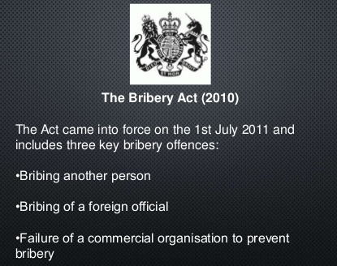
What can we do?
The Due Diligence Bureau:
Helps publishers to educate all intermediaries of the appropriate levels of conduct.
Provides assurances from intermediaries that the law will be adhered to.
Allows publishers to demonstrate compliance and the measures they’ve taken to prevent unlawful behaviour.
Step-by-step procedures help companies effectively implement anti-bribery due diligence.
With PSI’s DDB service you will be able to say:
“I am confident that my agent, reseller, supplier etc. does not make corrupt payments, and that our business relationship is a normal, legitimate one. I can explain to, and convince others why my confidence is justified.”

Slide 6
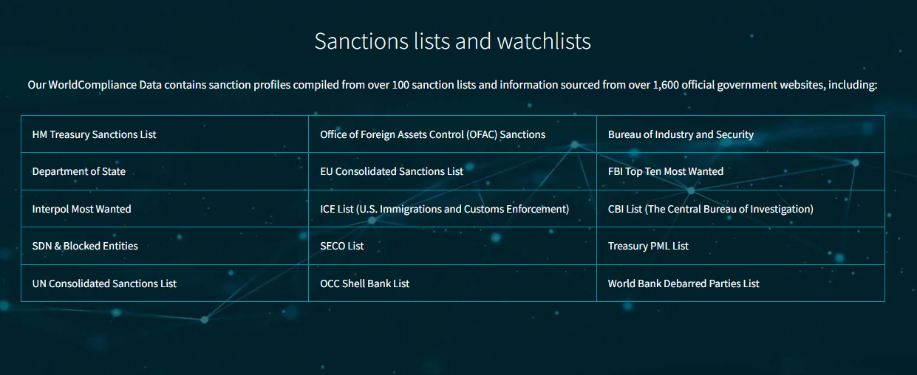
PSI’s DDB service supports publishers navigating the legal landscape
Intermediaries are vetted with respect to:
Sanctions
Bribery
Convictions
Fraud
Corruption
Money Laundering
Modern day slavery
Checks are carried out using LexisNexis Risk Solutions to provide comprehensive sanctions watchlist screening.

Slide 7
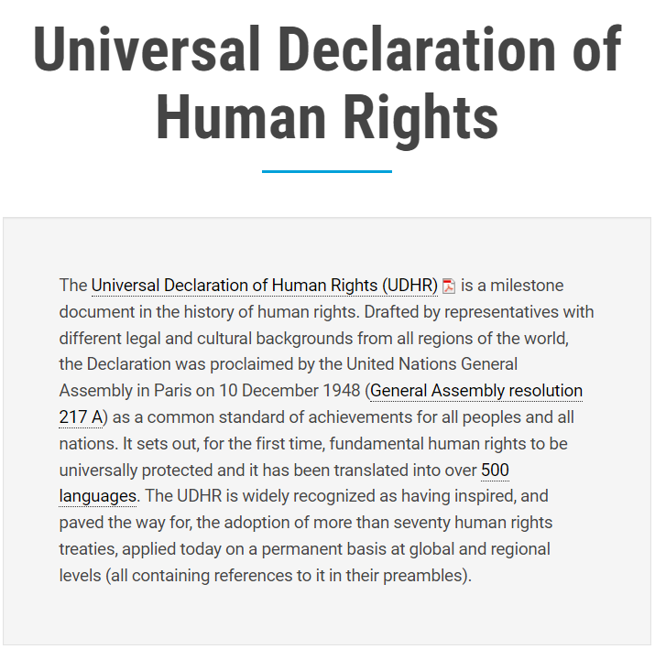
PSI’s DDB service covers the issues of human trafficking & modern slavery
This means that publishers using our DDB service can also demonstrate observance of Article 4 of the UN's Universal Declaration of Human Rights.
https://www.un.org/en/about-us/universal-declaration-of-human-rights

Slide 8





How does it work?
1)
2)
Publisher provides list of intermediaries / agents
Publisher list is matched against DDB database
3)
Compliance questionnaire sent to intermediaries / agents
4)
References are requested and details are stored in the database.

Slide 9
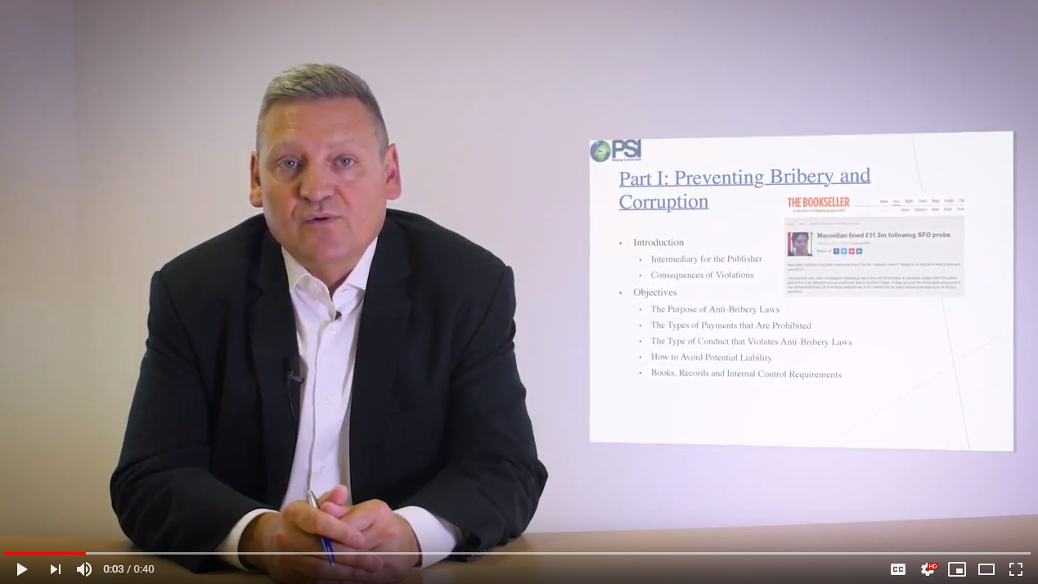
4)
Intermediaries confirm they have watched the training video.

Slide 10


6)
Up to 5 follow-ups and chasers if required
7)
When replies are received intermediaries are checked using LexisNexis and Internet searching
8)
Result uploaded to database (with company data, reports and evidence)
Checking for evidence of either legitimate business or instances of “negative news”

Slide 11
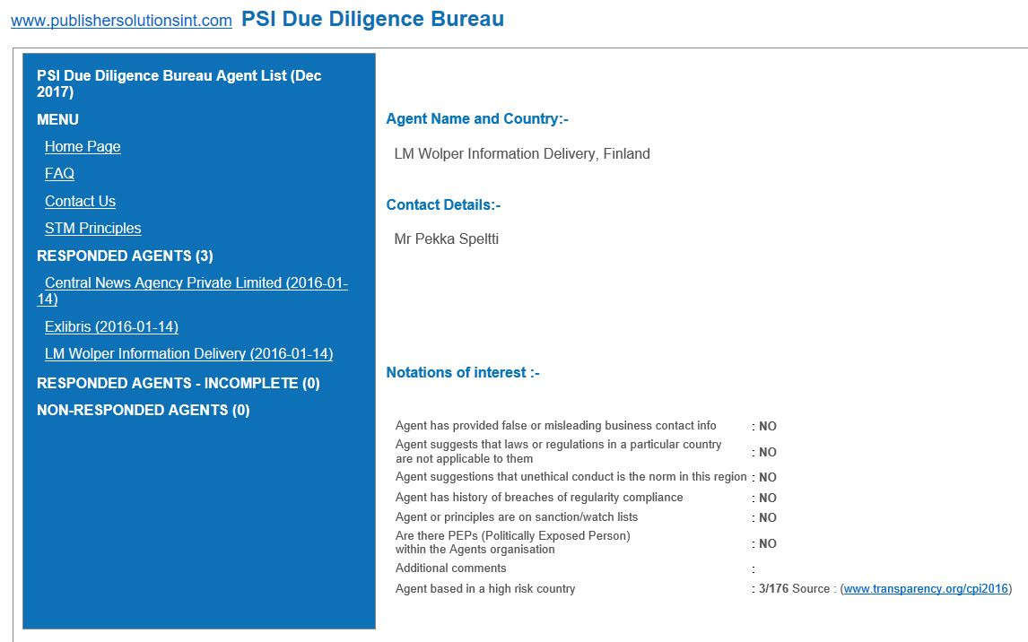


Results
Provided in regular reports
And available via DDB interface
XX Xxxxxxx xxxxxxxxxxx xxxxxxxx, xxxxxxx
XX Xxxxx Xx xxxx
Xx xxxx Xxx xx Xxxxxxx Xxxx x xxxxxxx,
Xxxxxxx
Xx xxxx Xx x xx Xxxxxx Xxxx x x

Slide 12


Benefits
Decisions can be made based on the information provided
Company passes compliance tests

Slide 13


For further information please contact:
info@PSIregistry.org
Other PSI products available include:
Touchstone– OA analytics and denials reporting
theIPregistry.org – the IP management tool
PSI Gap Analysis Tool – access a databank of customers subscribing to the content of over 150 STM publishers
PSI Data Audit – clean, deduplicate and enrich your customer data
Photo by Crew on Unsplash

